Slide 1
Designs

Slide 2
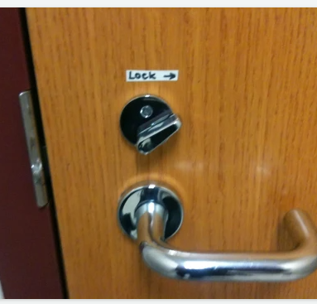
Good or Bad?

Slide 3
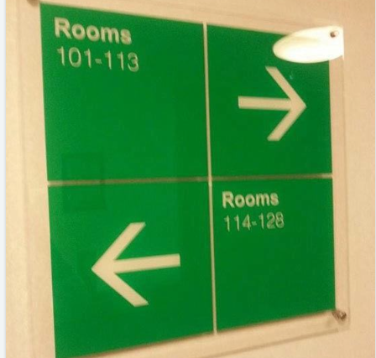
Good or Bad?

Slide 4
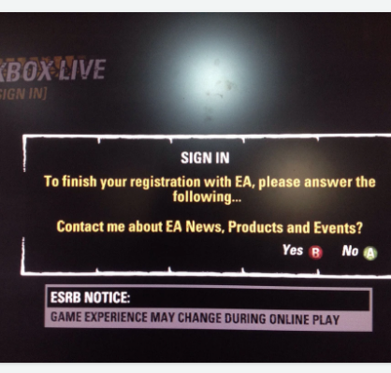
Good or Bad?

Slide 5
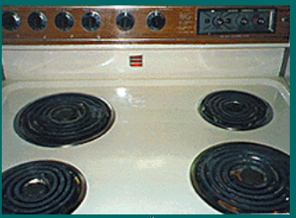
Good or Bad?

Slide 6
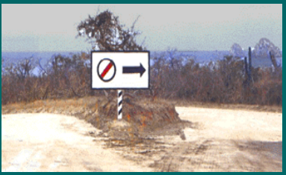
Good or Bad?

Slide 7
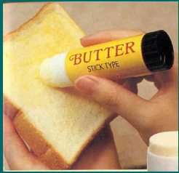
Good or Bad?

Slide 8
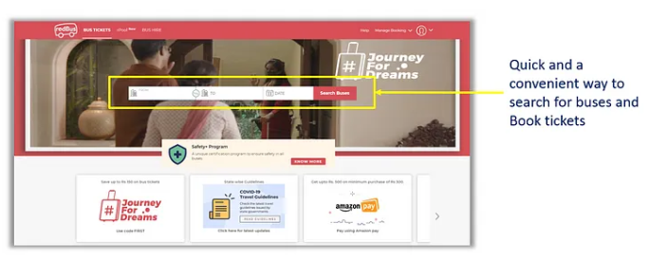
Good or Bad?

Slide 9
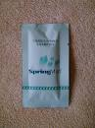
Good or Bad?

Slide 10
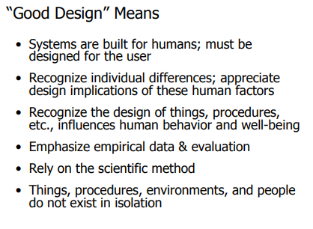

Slide 11
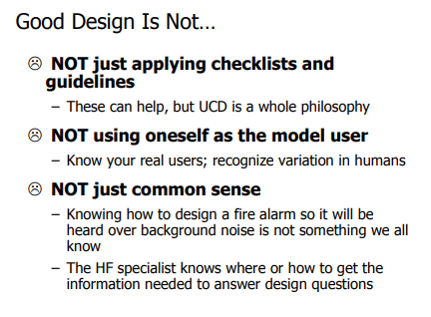

Slide 12
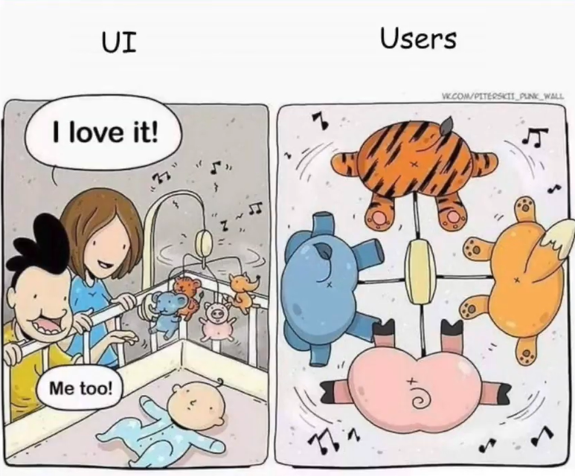


And always remember…
… you are not the user!

Slide 13
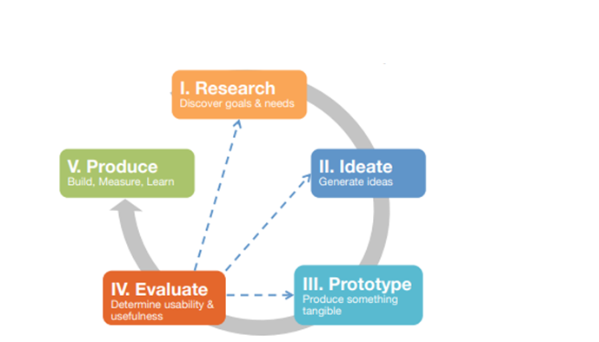
Design process at a glance

Slide 14
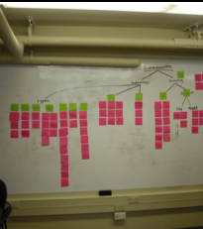
Today’s Agenda
Design Process
Group formation
Problem space
Research

Slide 15
Group Formation

Slide 16
Problem Statement

Slide 17
Problem Space
Narrow down the problem space
Decide who to concentrate on
Identify what is the real problem

Slide 18
Formulate Problem Statement
Who is affected?
Who is experiencing the problem? Can this user be further specified (by demographic, persona, motivation, reason for being in the situation)?
What is the problem?
What are the struggles? What task needs to be accomplished? What pain point needs to be relieved?
Where does it happen?
What is the context in which the user experiences the problem? Is it in a physical or digital space? Who else is involved?
Why does it matter?
Why is this problem worth solving? What value does it bring to the user? What value does it bring to the business?

Slide 19
Formulate Problem Statement
Our (who) has the problem that (what) when (where). Our solution should deliver (why).
Example: “Our new mum has the problem that she has no one to talk to about the best way to care for her baby when she is at home alone every day. Our solution should deliver a way for her to feel connected to other mums so she feels less isolated and alone.”

Slide 20
Research

Slide 21
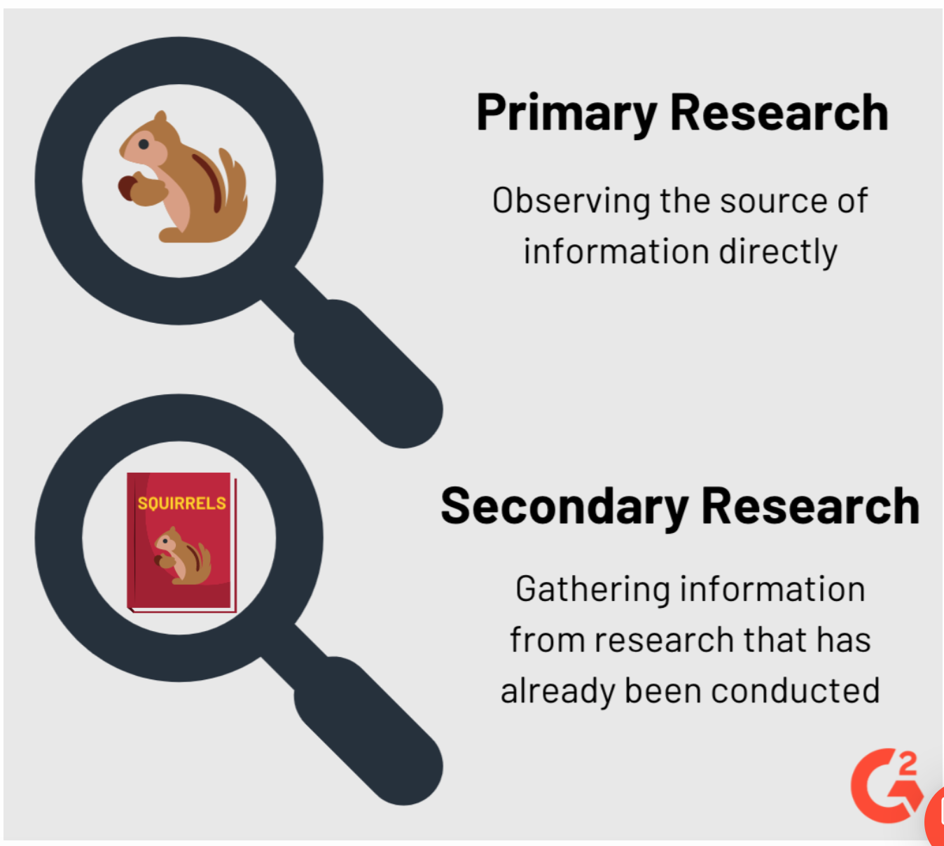
Primary vs Secondary Research

Slide 22
When and why do we conduct secondary research?
When?
Secondary research is easy to do and should be the first step in any systematic investigation.
Why?
Establish what has already been done and what hasn’t and identify knowledge gaps and niches to suggest a research direction, methods, theories and/or potential contributions.
"If I have seen further, it is by standing upon the shoulders of giants”
------ Newton
Note: Every Project starts with Secondary Research.

Slide 23




Secondary Research
Possible sources of secondary research include:
Books, Research papers, Journal articles, Conference papers
Marketing, Consumer and Economic Data
Museums, Archives, Archaeological sites, Satellite Imagery, Large Datasets
Records and statistics from government, non-government organizations (NGOs)
Newspapers, Tech Magazines, TV shows, Youtube, Social Media, etc.

Slide 24
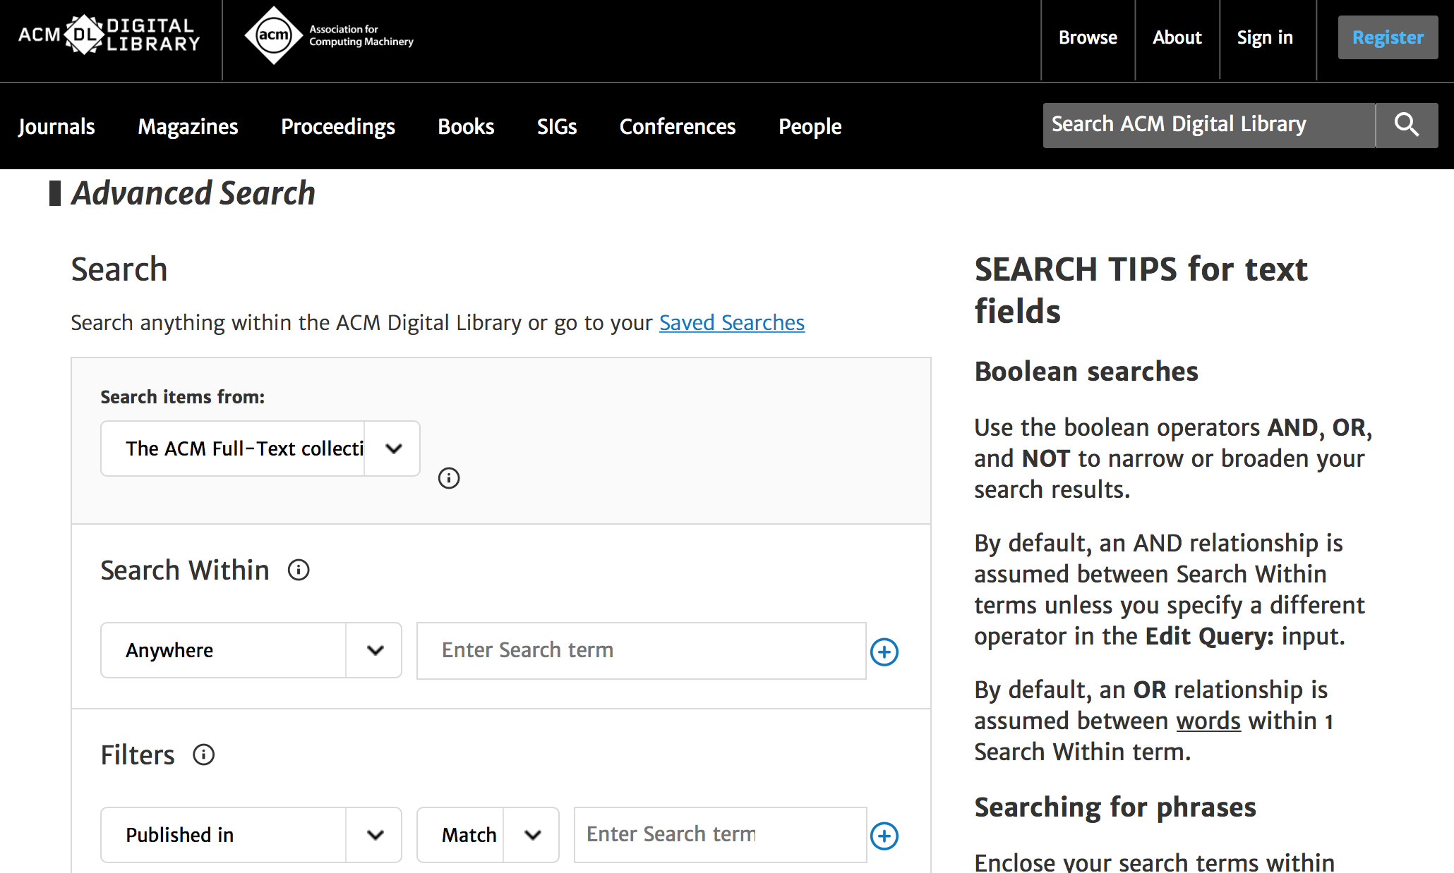
Secondary Research
We can search for these sources on the internet, for example:
ACM digital library
Notes:
Show the ACM Digital Library
https://idp.login.iu.edu/idp/profile/cas/login?execution=e1s2

Slide 25
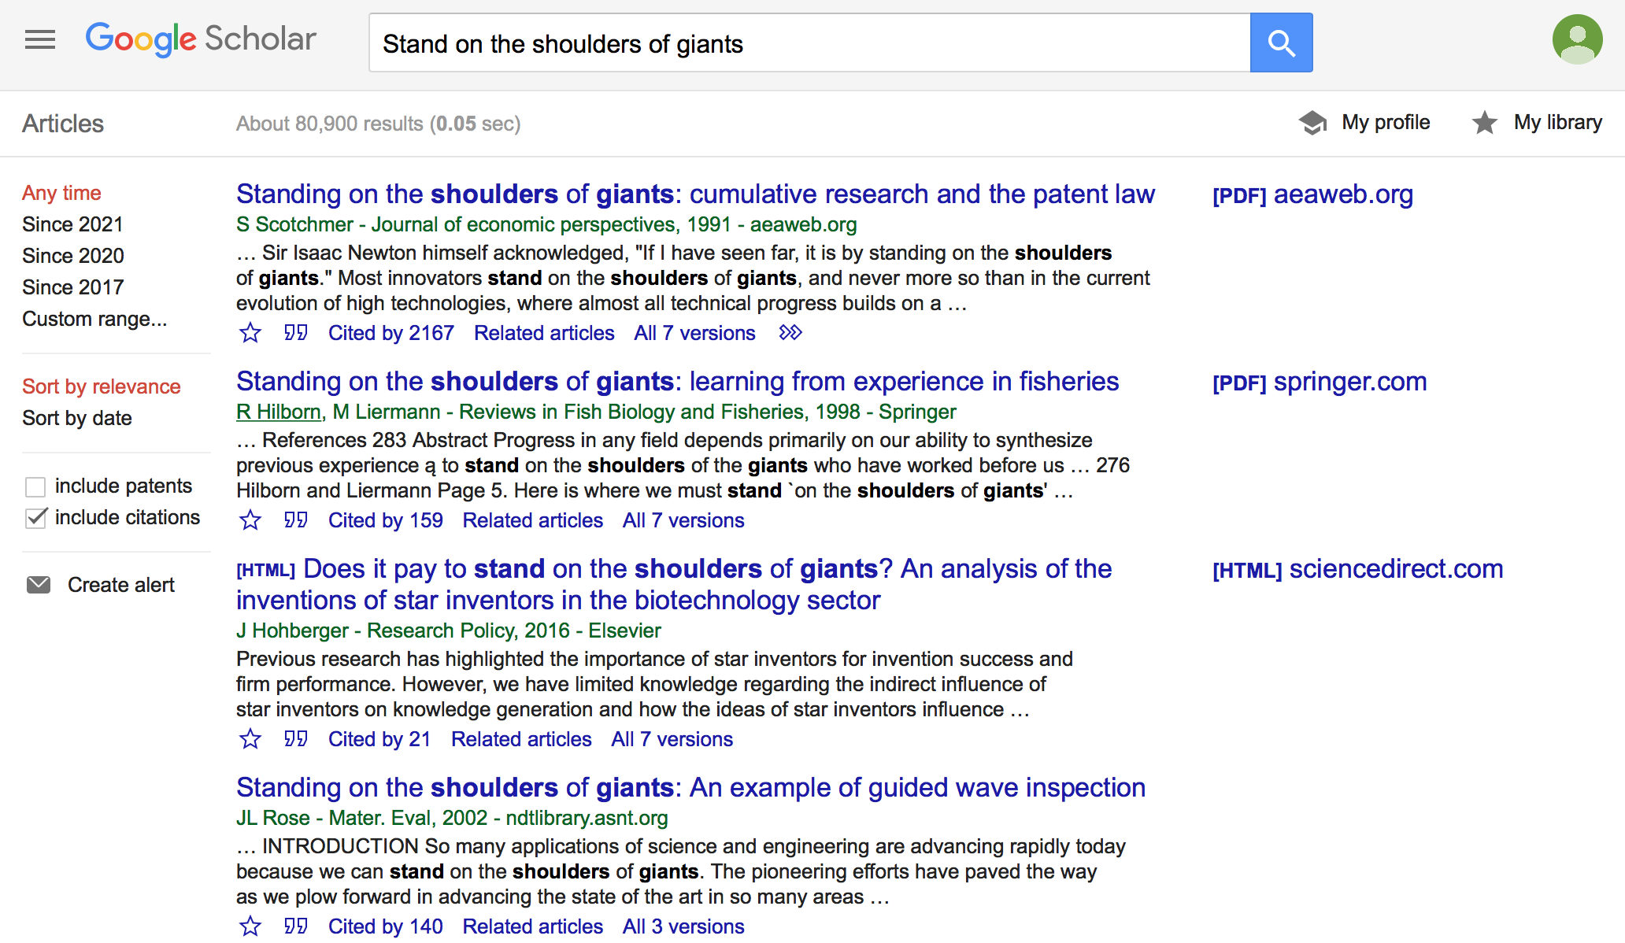
Secondary Research
We can search for these sources on the internet, for example:
Google Scholar
Notes:
https://scholar.google.com/

Slide 26
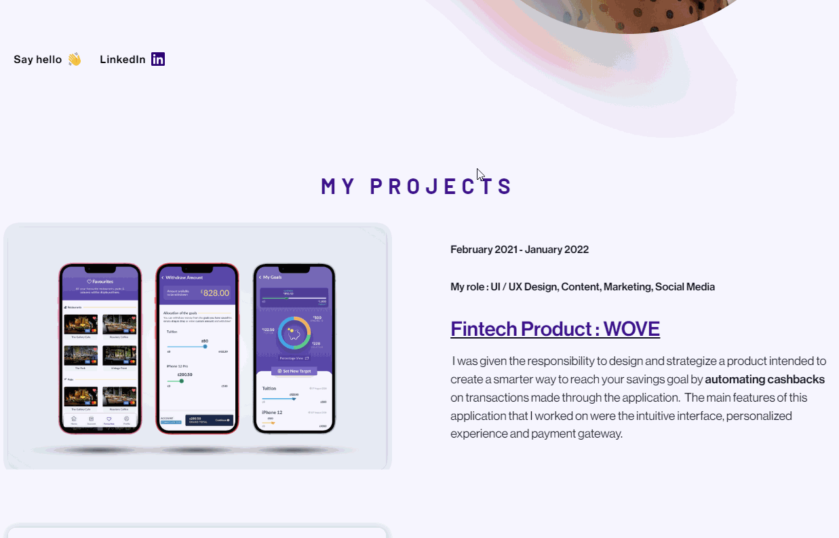
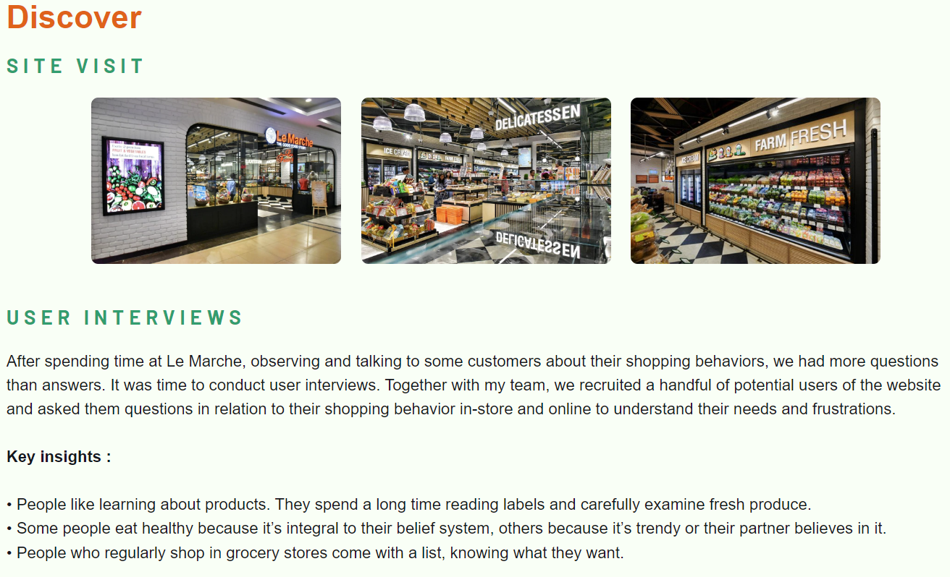
Secondary Research
For designers, possible sources of secondary research may also include:
precedent projects, products or case studies documented in various ways;
photographs, maps, diagrams, and other visual support records;
Portfolio by Maliha Hashmi https://www.malihahashmi.com/

Slide 27
In-Class Activity

Slide 28
Identify Problem space
As a group identify a problem space
Can explore conferences, i.e., CHI proceedings for inspiration
Write a problem statement
Upload the problem statement on Miro board

